Slide 1
Methods 2 Classroom 8

Slide 2
TODAY
Derivatives in multiple dimensions: Concavity & convexity, inflection points , partial derivatives and gradients
Remember to keep asking if you are stuck ☺

Slide 3
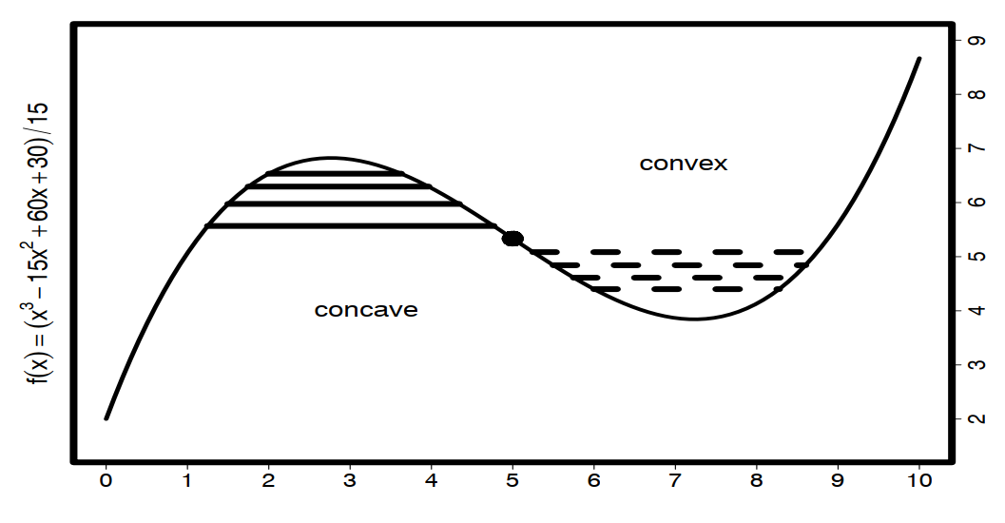


Convex & Concave
Concave over some interval of x if:
Convex over some interval of x if

Slide 4
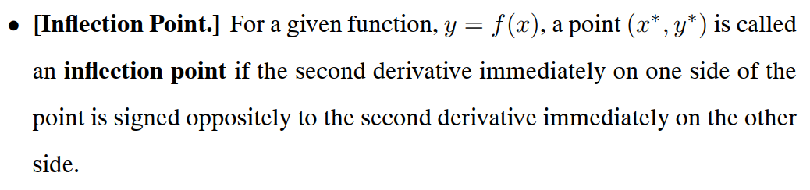
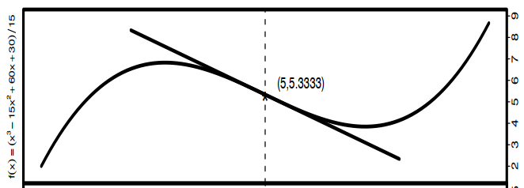
Inflection point

Slide 5
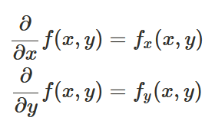



Partial Derivatives
Finding the partial derivatives in the example of two variables:
In practice find the derivative wrt. to det chosen variable (e.g. x or y) and treat the other one as a constant
Example:
has the following partial derivatives

Slide 6

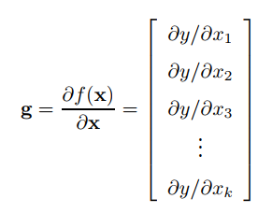
Gradients
The gradient g for a function f(x) with an input vector x is the vector of partial derivatives with respect to each element in x
Interpretation: The direction of the gradient is the direction in which the function increases most quickly, and the magnitude of the gradient is the rate of increase in that direction

Slide 7
Exercises
6.4
6.7
6.9
6.1 (only do the first 4 and try to graph the functions in R)
As well as a couple of exercises in the notebook ☺
If you have more time. Finish exercises from last week or do more exercises from chapter 6 (for instance 6.11).
Link to the exercise notebook: https://classroom.github.com/a/WLYqP0Oa

